Slide 1
Infrastructure & Operations:
Cloud Foundations Roadmap
2025

Slide 2
Document Status
Document Status:
Date : November 24th, 2025
Status: Approved
Awareness:
TTO Roadmap Program Leadership: November 4th, 2025
I&O Roadmap Leadership: November 18th, 2025
Approval:
Approved November 24, 2025 by:
Chief Technology Officer, SVP I&O: Charles Lewis
Chief Enterprise Architect: Kaushik Venkatadri
VP Platform Engineering, I&O: Joe Kitchen
Author:
Santhosh Kumar Chandrashekar, Enterprise Architecture
Roadmap Working Group:
Dan Caruso & Team, Infrastructure & Operations
Gord Rempel, Enterprise Architecture

Slide 3
Table of Contents
Topic | Page
Vision | 3
Value Chain Map | 4
I&O Guiding Principles | 5
Domain Overview | 6
Strategic Roadmap Focus Areas & Transformation Opportunities | 7
Capability Mapping | 8 - 9
Current State | 10 - 15
Target State | 16 - 19
Work Packages / Initiatives Identification and Sequencing | 20 - 24
Appendix | 25 - 30

Slide 4
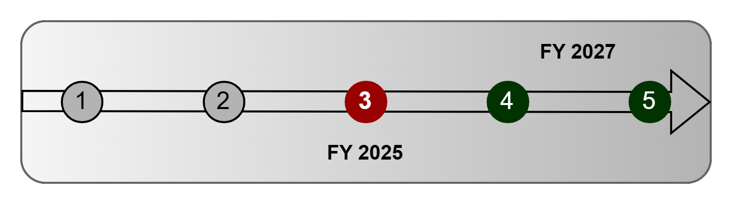
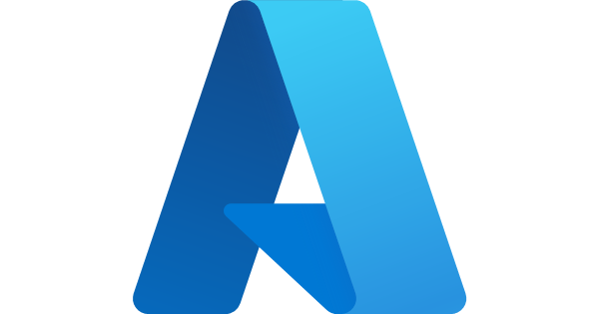

Advancing Enterprise Multi-Cloud Maturity
Vision Statement : Advance a secure, resilient, and scalable multi-cloud foundation across Azure and AWS into a mature state to accelerate data driven decision making,
automate enterprise operations and maximize business outcomes, while ensuring a smooth and low-risk GCP exit.
Agility
Resilience
Compliance & Security
Customer Experience
Cost Optimization
Enterprise
Cloud Value
Pillars
Business Outcomes
Accelerate Time-to-Market
Increase Service Resilience
Strengthen Security Posture
Improve Customer Experience
Reduce TCO
“Powering the enterprise with automated, secure, resilient and scalable cloud platforms for every business initiative”

Slide 5
Cloud Foundations Value Chain
The I&O Cloud Foundations Value Chain defines the end-to-end journey from planning to optimization. These chains emphasize delivering value through standardized, secure, and efficient cloud operations, enabling faster innovation and compliance.
Value Chain
Planning
Provisioning
Operations
Optimization
Decommission
Key Processes / Activities
Assess business needs
Define cloud strategy (Azure / AWS focus)
Plan migrations from GCP
Automate landing zones
Provision compute, storage, network
Integrate identity & access
Monitor performance & security
Manage incidents & changes
Ensure compliance audits
Analyze costs & usage
Optimize resources
Apply AI driven insights
Retire legacy GCP assets
Deprovision unused resources
Archive data securely
Key constituents
Business Units
IT Leadership
Cloud CoE
DevOps Teams
Application Owners
Security Teams
Operations Teams
Compliance
Vendors (Azure/AWS)
FinOps
Analytics Teams
Optimization Specialists
Migration Teams
Data Stewards
Audit Teams
Enterprise Architecture Engagement: Contributes to Cloud Strategy & Planning, ensures governance alignment across all lifecycles.
This supports journeys like "Business Application Hosting" on Cloud platforms.
Business Request
Automated Provisioning in Azure/AWS
Secure Operations
Continuous Optimization
Safe retirement of legacy workloads

Slide 6
I&O Guiding Principles
Guiding Principles
Cloud
Appropriate
Cloud first, cloud appropriate. Leverage pattern-based decision frameworks to inform multi-cloud solution deployment.​
Buy before
Build
Whenever possible, choose solutions that abstract management and operations. SaaS are our first choice, followed by PaaS, followed by IaaS.​
Responsible Autonomy
Practitioners are trusted to act in the best interest of the company and our customers. Flexibility at the edge governed by a strong foundation.​
Automation Everywhere
Solutions are deployed through automated provisioning, configuration, integration, deployment and management.
Experientially Focused
Putting the customer at the center of everything we do. This means placing a high value on the experience.
Value
Oriented
Outcomes are connected to value where velocity, frequency, experience, resilience and total cost of ownership are weighted considerations.
E2E
Observability
Prioritize unified, real-time visibility and insights into the health, performance and behaviour of services.​
Secure
by Design
Solutions are governed by a multi-layer security architecture, policy-driven enforcement, data protection and incident detection and handling.
Continuous Optimization
Programmatic measurement and feedback loops to promote efficient use of technology and processes.​

Slide 7
Six Strategic Domains Driving Cloud Foundations
The I&O Cloud Foundations Roadmap is structured across six strategic domains, each domain strengthens enterprise agility, resilience, and value realization from cloud investments. These domains focus efforts on foundational risk areas and enable targeted delivery of transformation initiatives.
Foundation
Delivers resilient networking,
inter-regional connectivity,
and robust infrastructure log forwarding to support resilience, scalable and secure cloud operations.
Security
Ensures cloud data, workloads, and platforms are protected from malware and unauthorized access, embedding security requirements and controls across services.
Governance
Unifies platform approaches
and enforces compliance,
standardizing governance,
retiring legacy platforms,
and enhancing cloud data classification.
Platform &
Services
Drives modernization with multi-region, multi-cluster, and advanced service mesh capabilities to enable resilient, scalable, reliable application deployments.
Cost &
Optimization
Improves tagging automation, SaaS migration, and multi-cloud spend visibility to reduce financial risk and
Optimize cloud investments.
Automation
Accelerates infrastructure delivery, enables chaos resiliency testing, and implements self-healing/proactive recovery for continuous availability.

Slide 8
Strategic Focus Areas and 2027 Cloud Transformation Opportunities
These focus areas translate cloud priorities into measurable opportunities that advance enterprise agility, resilience and cost efficiency by 2027.
Strategic Focus Areas
Transformation Opportunities
Platform Resilience and Connectivity
Strengthen inter-region and multi-cloud connectivity
Improve platform reliability and disaster recovery resilience
1
Strengthen Platform Connectivity and Resilience
Improves service reliability, recovery speed and customer experience
Security and Governance
Advance security and governance across cloud environments
Standardize hardened images and scanning controls
2
Elevate Security and Governance Posture
Enables Stronger Security Posture and Compliance Readiness
Operations and Automation
Expand self service provisioning capabilities through automation
Enhance resilience with chaos and recovery testing
3
Automate for Operational Efficiency
Accelerates delivery, enhances agility and reduces operational friction
Cost Optimization and Insights
Enhance cost transparency with unified tagging and FinOps
Rationalize workloads to optimize spend and placement efficiency
4
Optimize Cost and Observability Insights
Reduces TCO and Improves Financial Visibility

Slide 9
Capability Mapping
For Capability Mapping, I&O roadmaps are mapped to the Canada Life Technology Capability model.
The Canada Life Technology Capability model is based on the Technology Business Management (TBM) taxonomy.
Level 1 - 3 are standardized TBM taxonomy names, Level 4 are Canada Life specific modifications.
Technology categorization with descriptions:​
L1 Capability L2 Capability L3 Capability L4 Service Category Description
Delivery
Enabling Platforms
Foundation Platform
Cloud Service Catalog & Enablement
Central repository of all approved, active, and restricted cloud services. Ensures governance, discoverability, and safe adoption.
Cloud Migration Enablement
Provides frameworks, automation, and tools for all “7Rs” migration strategies, supporting secure, risk-managed migrations based on organization’s workload placement framework.
Cloud Container Platform Enablement
Supports EKS (AWS) and AKS (Azure) as strategic platforms. Drives project to retire GKE (GCP) and migrate Kubernetes workloads to AWS/Azure, ensuring operational focus and sustainability.
Cloud Governance & Workload Placement Framework
Maintains and enforces the organization’s workload placement framework to guide strategic cloud adoption decisions, ensuring each workload is placed in line with business, technology and policy requirements.
* Business Values for L4 level categories are listed in Appendix

Slide 10
Capability Mapping
For Capability Mapping, I&O roadmaps are mapped to the Canada Life Technology Capability model.
The Canada Life Technology Capability model is based on the Technology Business Management (TBM) taxonomy.
Level 1 - 3 are standardized TBM taxonomy names, Level 4 are Canada Life specific modifications.
Technology categorization with descriptions:​
L1 Capability L2 Capability L3 Capability L4 Service Category Description
Delivery
Enabling Platforms
Foundation Platform
Cloud Platform Provisioning & Landing Zones
Automated secure, and compliant setup of cloud environments in AWS and Azure, accelerating business onboarding and project start.
Infrastructure as Code & Platform Automation
Codified provisioning, config management, and CI/CD enablement for consistent, scalable governable cloud deployments.
Identity & Access
Centralized, least-privilege access controls and automated policy enforcement for secure operations at scale.
Cost Management & Resource Optimization
Spend visibility, tagging, budgeting and automated optimization for cloud cost stewardship and efficiency.
* Business Values for L4 level categories are listed in Appendix

Slide 11
Current State​

Slide 12
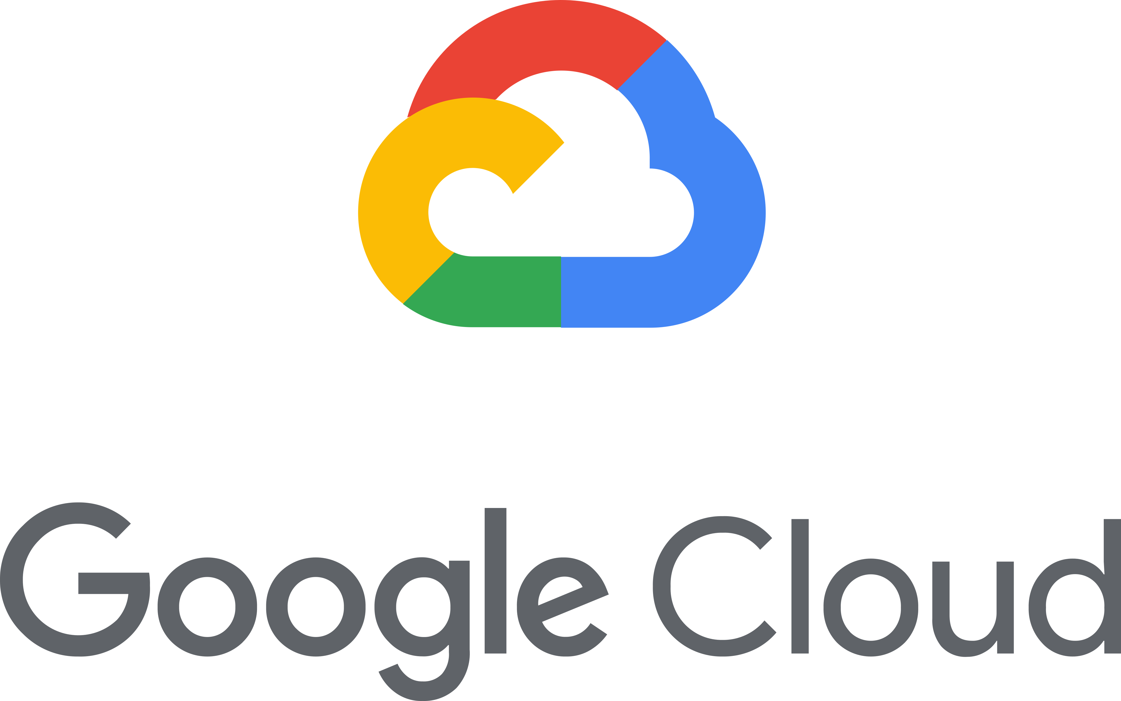
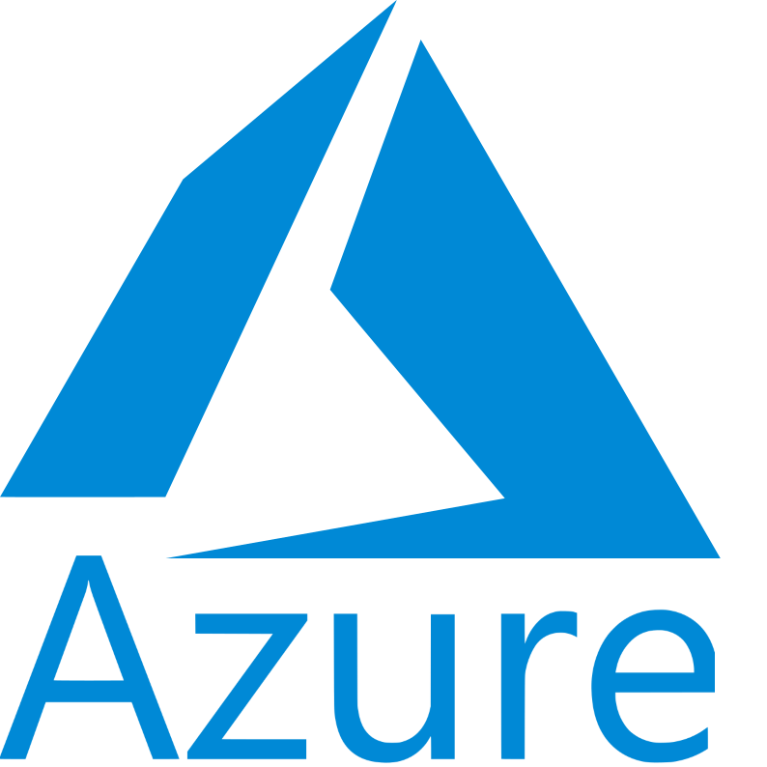
Enterprise Cloud Landscape
Strategic platforms for service hosting
Why Hybrid Multi-Cloud?
Scalability, security, cost, control, and speed
More flexibility and avoiding vendor lock-in
High availability to prevent website outages
Strong data protection and risk mitigation plan
Best latency and load times for customers
Competitive pricing between cloud providers
Constant access to network performance improvements
Following region-specific compliance rules
GCP Exit in progress
SaaS offering Apigee to remain in GCP
Canada Life operates in a Hybrid multi-cloud platform environment which enables innovative optionality and flexibility and protects Canda Life from supplier concentration risk.
Active-Active foundation across region(s) (Azure, AWS, GCP)
Platform services are highly resilient
Significant catalog of platforms and services available from each cloud provider

Slide 13
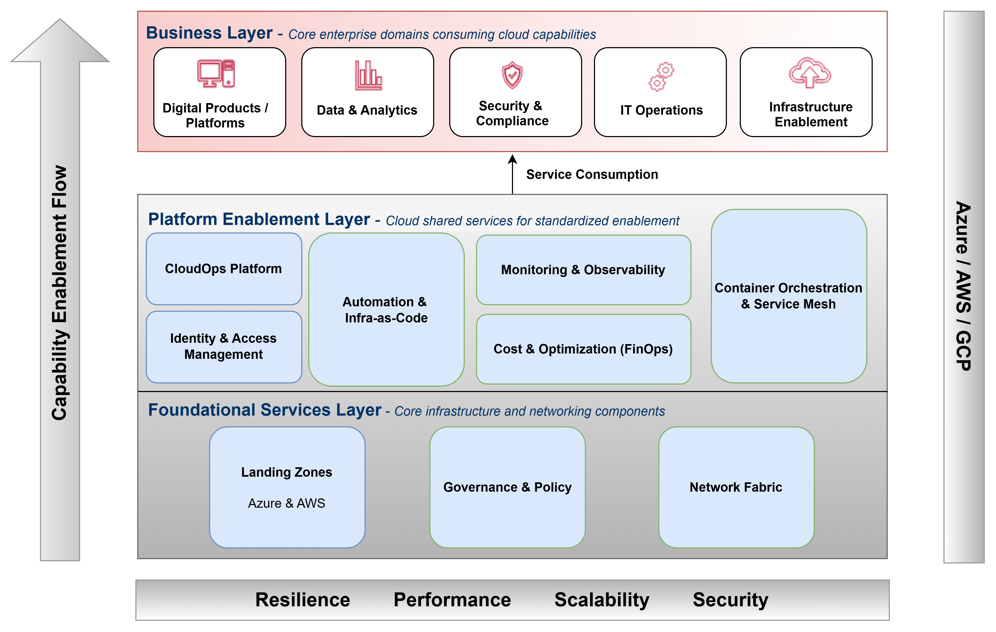
High Level Current State Architecture

Slide 14
5 Level Cloud Maturity Model – Aligned with AWS & Microsoft CAF
* Level | Name | What it Means (Cloud Foundations) | Measurable Indicators
1 | Initial | Ad-hoc use; siloed pilots; minimal standards/governance. | <20% IaC coverage; ad-hoc accounts; low tagging; basic monitoring only
2 | Managed | Foundational guardrails in place; landing zones; basic automation; repeatable patterns. | 40–60% IaC; RBAC baseline; 70% resource tagging; starter CI/CD; cost reporting exists
3 | Defined | Enterprise standards & reference architectures; governed operations; integrated DevOps; baseline FinOps & SecOps. | 70–85% IaC; policy-as-code; centralized logging/metrics; FinOps dashboards; security automation
4 | Measured | Data-driven operations; SRE embedded; multi-cloud consistently governed; proactive resilience & cost control. | SLO/SLI & error budgets; 90%+ automated provisioning; drift = near-zero.
5 | Optimized | Continuous improvement; AI-Ops & auto-remediation; adaptive governance; cloud KPIs tied to business outcomes. | >95% auto-remediation; predictive scaling; policy auto-fix; KPIs linked to OKRs (e.g., cost-to-serve, lead time)
Current
Maturity
Level
People Process Technology
* Levels adapted from Gartner cloud strategy guidance and industry best practices.
Aligned to AWS Cloud Adoption Framework (Assess → Mobilize → Migrate & Modernize → Operate → Transform), and
Microsoft Cloud Adoption Framework (Plan/Ready → Adopt → Govern/Manage → Innovate).

Slide 15
Cloud Capability Maturity: Current vs Target State
Assessment Approach:
Based on AWS and Azure Cloud Adaption Frameworks,
Validated through stakeholder discussions and cloud vendor audits.
Key Insight:
Solid foundation in provisioning,
Uplift required in security integration, automation scale,
and unified governance.
Target Alignment:
Benchmarked against AWS and Microsoft CAF to guide roadmap maturity goals.
Capabilities | Current State | Target State | Change Focus
Platform Foundation | 3 | 4 | Incremental improvement
Platform Automation | 4 | 5 | Scale automation enterprise-wide
Security & Identity | 2 | 5 | Major uplift required
Monitoring & Insights | 3 | 5 | Expand observability & analytics
Cost & Optimization | 3 | 4 | Standardize policy and controls
Governance & Risk | 3 | 5 | Strengthen tagging & transparency

Slide 16
Evolving from Current State Insights to Future-Ready Cloud Focus Areas
Current Observations
Strategic Focus for Future State
Platform Diversity:
Multiple cloud and container platforms in use, leading to varied operational models.
Platform Streamlining:
Align on core container platforms (e.g.,AKS/EKS) and rationalize GCP workloads & Frontdoor.
Security Maturity:
Inconsistent implementation of enterprise security controls and scanning practices.
Security by Design:
Embed enterprise security patterns and standardized hardened builds.
Automation Coverage:
Strong automation foundation with scope to expand into self-service and resilience validation.
Automation at Scale:
Leverage automation maturity to enable full self-service, predictive monitoring, and resilience testing.
Governance Consistency:​
Established governance model, but policies and workload placement applied inconsistently across teams.​
Unified Governance:
Standardize policies and workload placement through automated guardrails.
Cost Visibility:​
Cloud spend visibility improving, but further optimization opportunities.​
Cost Optimization:
Mature FinOps practices for automated spend insights and efficiency
Skills Alignment:​
Teams at varying maturity levels across Azure and AWS capabilities.​
Workforce Enablement:
Invest in cross-cloud upskilling and targeted certifications.
Notes:
Catagories

Slide 17
Target State​

Slide 18
Design Principles for Target State Architecture & Expected Business Outcomes
Key Design Principles
Expected Business Outcomes
1
Cloud-Agnostic Abstraction:
Foundation capabilities modeled for Azure & AWS equivalence.
1
Cost Efficiency:
Contain spend growth through optimization while enabling business expansion.
2
Resilient Modular Architecture:
Separate but integrated landing zones, policies, and automation.
2
Speed to Value:
Accelerate time-to-market for business products and automated services.
3
Security & Governance by Design:
Policy-driven guardrails, automated compliance.
3
Risk & Compliance:
Reduce operational risk via unified cloud governance and security.
4
Data-Centric Visibility:
Unified telemetry, FinOps for traceability.
4
Strategic Focus:
Simplify IT landscape by exiting non-strategic cloud providers.
5
Progressive Retirement of GCP Workloads:
Freeze/migrate workloads by phase-out date.
5
Cloud Maturity Uplift:
Target 4+ (measured) ratings across all radar assessed cloud capability.
Notes:
Catagories

Slide 19
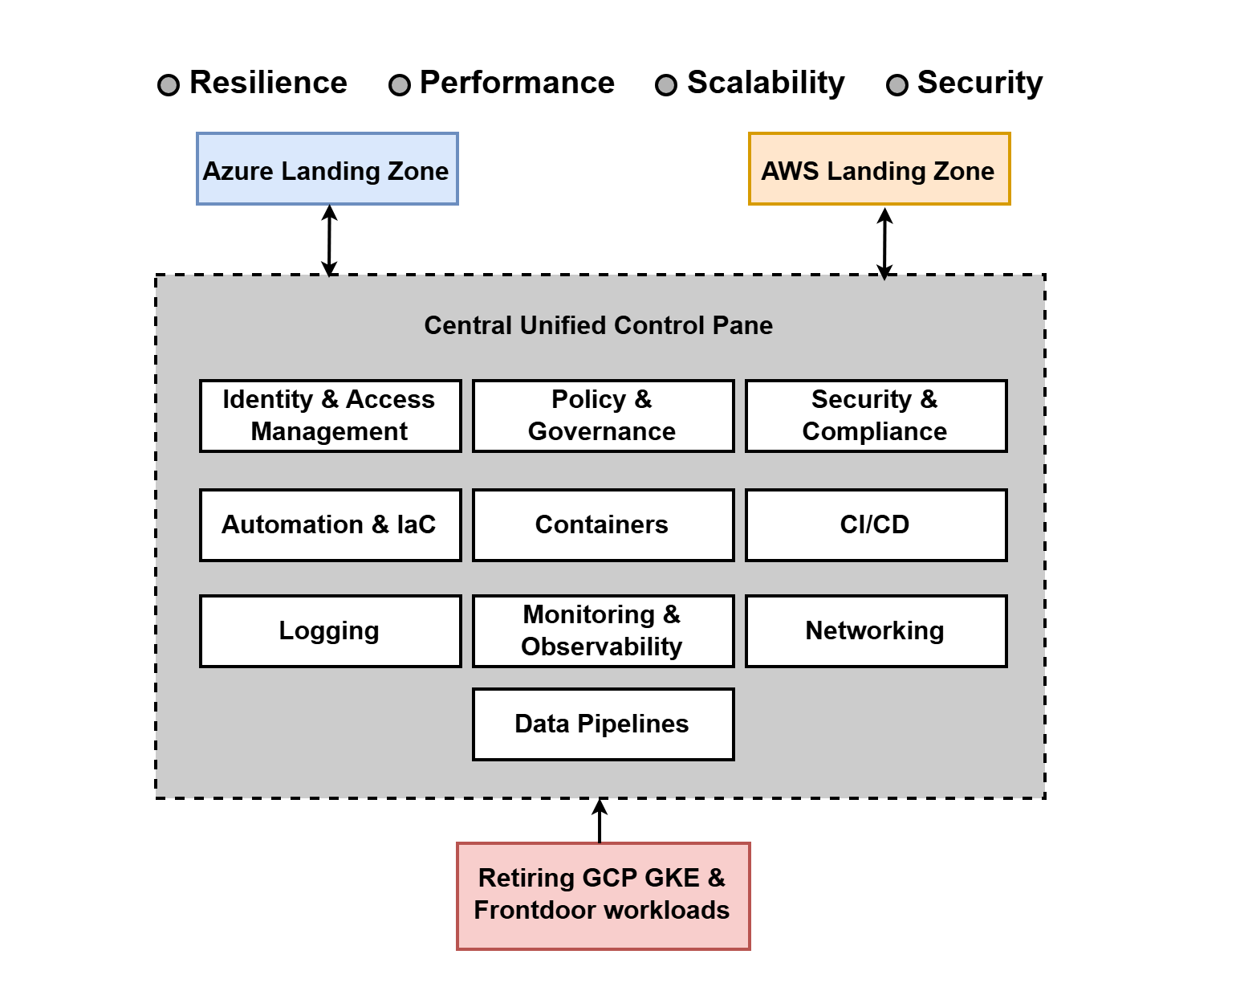
High Level Target state architecture
The target architecture advances the cloud foundation to a secure, resilient, unified, scalable and automated state across Azure and AWS, supporting smooth GCP workloads (GKE & Frontdoor) exit and multi-cloud operations.
This future state architecture enables:
Centralized governance and compliance through unified policies and identity frameworks, ensuring consistent security and regulatory adherence across clouds.
Resilient and automated landing zones designed for each cloud provider, facilitating scalable, secure workload deployments with automated guardrails.
Unified logging, monitoring, and cost management to provide operational visibility, proactive issue detection, and financial control across all cloud environments.
Self-service capabilities for development teams that empower faster innovation through on-demand provisioning and automated workflows.
Reference architecture and patterns supporting workload migration, modernization, and integration, accelerating digital transformation initiatives.

Slide 20
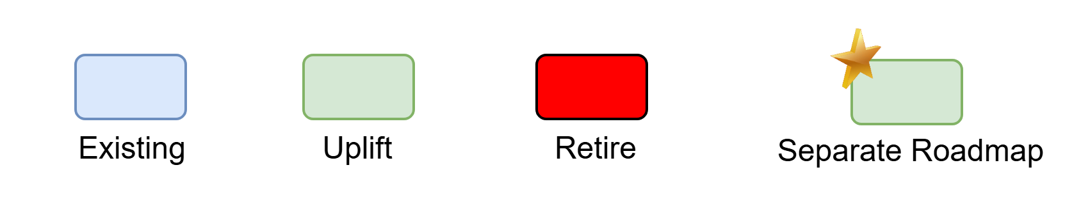
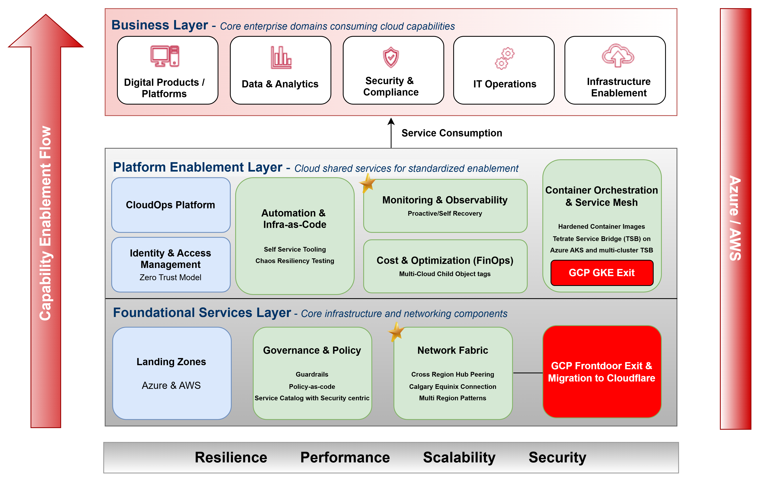
Unified Target High Level Architecture

Slide 21
Work Packages / Initiatives Identification and Sequencing
​

Slide 22
Roadmap Priorities & Pain Points Summary
Domain
Foundation
Security
Governance
Platform & Services
Cost & Optimization
Automation
Priority Name | Rank | Pain Point | Business Impact / Growth Drivers
Cross Region Hub Peering | Low | Inter-regional traffic via Equinix routes | Reduced latency with inter-regional peering
Calgary Equinix Connection | Low | Regional failure containment needed | Decouple Canada west region from Central
Cloud Log Forwarding Platform | High | Inconsistent log forwarding, costly tools | Cost savings with Cribl, better observability
Cloud Storage Antivirus Protection | High | Files scanned only on copy, no active scan | Enhanced security with Antivirus solution
Service Catalogue with Security Centric View | High | Lack of security controls in Catalogue / EADP | Improved governance with updated controls
Hardened Container Image Platform | Medium | Challenging due to image volume | Secure container deployment
Unified, Governed Container Platforms | Medium | Disparate platforms increase overhead | Centralized governance across clouds
Data Classification in Cloud | Medium | No data classification in cloud environments | Data protection via DAM project
Multi Region Patterns | Low | Need for multi-region design patterns | Faster time to market for use cases
Tetrate Service Bridge (TSB) Enhancements | Medium | Single cluster risk, Azure integration | Multi-cluster failover, service mesh on AKS
Network Security Groups Automation | Low | Manual segmentation limits efficiency | Automated micro segmentation
Tagging Automation | Medium | Child objects not tagged | Improved cost tracking with multi-cloud tags
Frontdoor Migration | Medium | GCP reliance | Risk mitigation, Cost savings via SaaS migration
Self Service tooling | Medium | Lack of self-service for infra delivery | Faster delivery with IaC tools
Chaos Resiliency Testing | Medium | No testing for resilience | Resilience/availability
Proactive/Self Recovery | Low | Slow recovery from outages | Reduced downtime with self healing
* Detailed priority objectives in next slides

Slide 23
Strategic Work Packages / Initiatives & Objectives - Cloud Foundations Specific
Category
Work Packages / Initiatives
Objective
New Work Package/Initiative
Cloud Foundations I&O Specific
C1: Cloud Log Forwarding Platform | Reduce complexity and costs of cloud native log bus, close gap on s3 based log retrieval, noise/volume reduction of shipped logs.
C2: Hardened Container Image Platform | Simplify container image currency management and lifecycle
C3: Tagging Automation | Introduce automated tag management via ServiceNow, ensuring CMDB updates are reflected on workload tags.
C4: Self Service tooling | Enabling teams to self-service common cloud patterns, increase efficiency by shifting left.
C5: GCP GKE workloads Exit | Decommission all workloads from GCP GKE and migrate to the target cloud platform to optimize cost, simplify operations, and align with strategic cloud architecture.
C6: Tetrate Service Bridge (TSB) Enhancements | Extend Tetrate Service Bridge to Azure for a centralized mesh solution.
C7: Chaos Resiliency Testing | Chaos testing as a service offering. Providing teams with the ability to deploy chaos testing for resiliency and DR scenarios.
C8: Network Security Groups Automation | Control and limit intra-VPC/VNET traffic with automated end to end rule sets. Strengthen our foundation security with additional layers of protect.
C9: Proactive/Self Recovery | Evaluate proactive monitoring tooling. Implement automated recovery solutions for common failure scenarios to reduce INC and recovery time.
C10: Multi Region Patterns | Prepare for future architecture with multi region deployment patterns for service catalogue.

Slide 24
Cloud Foundations Roadmap Dependencies – Network, Security & Observability Specific
Category
Work Packages / Initiatives
Objective
Network specific
Cross Region Hub Peering | Enable efficient routing between cloud regions, reducing latency and dependency on Equinix.
Calgary Equinix Connection | Align Equinix location with cloud region to ensure we have effective geo redundancy.
Frontdoor Migration | Reduce dependencies on non-strategic platform GCP.
Data Classification in Cloud | Close gap on data classification and visibility in Azure and AWS. (DAM Project)
Cloud Storage Antivirus Protection | Close gap on ability to directly scan object storage services
Service Catalogue with Security Centric View | Fortify Service Catalogue with detailed Security requirements, minimum policies, guardrails and affected rules (CSPM)
Event Driven Automation Design and Implementation | Enhance event driven automation and intelligent automation capabilities building on prior framework.
Security Specific
Observability Specific
I&O driven initiatives referenced in Network roadmap
Security driven initiatives
Cloud dependent initiative referenced in Monitoring & Observability Roadmap

Slide 25
Work Packages / Initiatives Sequencing (2026-2027)
2026
2027
Q1
Q2
Q3
Q4
Q1
Q2
Q3
Q4
C1
Cloud Log Forwarding Platform
  I&O driven initiatives as part of this Cloud roadmap
C
C2
Hardened Container Image Platform
C3
Tagging Automation
C4
Self Service tooling
C5
GCP GKE workloads Exit
C6
TSB integration in Azure
C7
Chaos Resiliency Testing
C8
NSG Automation
C9
Proactive/Self Recovery
Cross region hub peering
N
  I&O driven dependent initiatives referenced in Network roadmap
N
FrontDoor Migration
N
N
Calgary Equinix Connection
  I&O driven dependent initiative for C9 referenced in Monitoring and Observability roadmap
MO7
Event Driven Automation Design and Implementation
MO
25

Slide 26
Cloud Foundations – Work Packages / Initiative Details (Scope, Cost & Timeline)
Work Package / Initiative | Potential In-Scope Technology | Estimated Cost | Estimated Duration | Timeline
Cloud Log Forwarding Platform | Cribl | Internal Labour: Medium Vendor: $300k in licensing costs per year | 6 months | 2026 Q1 - Q2
Hardened Container Image Platform | Chainguard | Internal Labour: Medium $250k per year | 6 months | 2026 Q1 - Q2
Tagging Automation | Service now; Gitlab | Internal Labour: Medium BAU initiative | 6- 9 months | 2026 Q1 - Q3
Self Service tooling | Service now; Gitlab; additional broker evaluation in process | Internal Labour: Large Vendor: $100k in licensing and operational costs per year | 18 months | 2026 Q1 - 2027 Q2
GCP GKE workloads Migration | EKS | Internal Labour: Medium BAU initiative | 12 months | 2026 Q1 - Q4
Tetrate Service Bridge (TSB) integration in Azure | TSB Anywhere | Internal Labour: Medium Vendor: $600k in licensing costs per year across both AWS and Azure | 6 months | 2026 Q2 - Q3
Chaos Resiliency Testing | AWS Fault Injection Service AWS Resilience Hub Azure Chaos Studio | Internal Labour: Medium BAU initiative | 6 months | 2026 Q4 - 2027 Q1
Network Security Groups Automation | Service now; Gitlab | Internal Labour: Medium BAU initiative | 6 months | 2027 Q2 - Q3
Proactive/self-recovery | Splunk; Ansible; Terraform | Internal Labour: Medium BAU initiative | 6 months | 2027 Q3 - Q4
Labour estimates: Small: 1 - 2 months – 1 FTE, Medium: 3 - 6 months – 1 FTE, Large: > 6 months - 1 FTE

Slide 27
Appendix

Slide 28
Cloud Foundations Roadmap : Business Value
For Capability Mapping, I&O roadmaps are mapped to the Canada Life Technology Capability model.
The Canada Life Technology Capability model is based on the Technology Business Management (TBM) taxonomy.
Level 1 - 3 are standardized TBM taxonomy names, Level 4 are Canada Life specific modifications.
Technology categorization with descriptions:​
L1 Capability L2 Capability L3 Capability L4 Service Category Description
Delivery
Enabling Platforms
Foundation Platform
Cloud Service Catalog & Enablement governs access to approved cloud solutions while making it easy to discover and adopt new capabilities. Key benefits:
Governance: Only pre-vetted, compliant services are available for business use, reducing risk.
Discoverability: Teams can quickly find and utilize available services without lengthy approval cycles.
Duplicate services: Reduces unauthorized service usage by providing a transparent, curated catalog.
Security : Integrated approval workflows ensure security personnel review and authorize all new catalog services.
Cloud Migration Enablement accelerates secure and risk-managed migration to cloud by providing frameworks, automation, and support for all 7Rs migration strategies. Key benefits:
Accelerated Migration: Simplifies and expedites moving legacy workloads to strategic cloud platforms.
Reduced Risk: Structured migrations minimize downtime, maintain business continuity and setting up Azure Migrate and AWS Migration Hub factories.
Strategic Alignment: Ensures migrations are guided by 7Rs and workload placement frameworks and business priorities.
Cloud Service Catalog & Enablement
Cloud Migration Enablement

Slide 29
Cloud Foundations Roadmap : Business Value
For Capability Mapping, I&O roadmaps are mapped to the Canada Life Technology Capability model.
The Canada Life Technology Capability model is based on the Technology Business Management (TBM) taxonomy.
Level 1 - 3 are standardized TBM taxonomy names, Level 4 are Canada Life specific modifications.
Technology categorization with descriptions:​
L1 Capability L2 Capability L3 Capability L4 Service Category Description
Delivery
Enabling Platforms
Foundation Platform
Container Platform Enablement delivers value through strategic platform alignment, operational consistency, and efficient transition. Key benefits:
Streamlined Operations: Focuses investment and skills on AWS and Azure, lowering complexity and support costs.
Platform Transition: Manages GCP/GKE retirement and orchestrates safe migrations to EKS/AKS.
Long-Term Sustainability: Reduces technical debt and sprawl by consolidating onto supported platforms.
Cloud Governance & Workload Placement Framework ensures that all cloud adoption decisions maximize value while minimizing risk. Key benefits:
Decision Assurance: Guides strategic placement of workloads for performance, security, and value.
Risk Management: Controls data residency, cost, and compliance risks through standardized criteria.
Transparency: Ensures all placement processes are auditable, consistent, and aligned to business requirements.
Cloud Container Platform Enablement
Cloud Governance & Workload Placement Framework

Slide 30
Cloud Foundations Roadmap : Business Value
For Capability Mapping, I&O roadmaps are mapped to the Canada Life Technology Capability model.
The Canada Life Technology Capability model is based on the Technology Business Management (TBM) taxonomy.
Level 1 - 3 are standardized TBM taxonomy names, Level 4 are Canada Life specific modifications.
Technology categorization with descriptions:​
L1 Capability L2 Capability L3 Capability L4 Service Category Description
Delivery
Enabling Platforms
Foundation Platform
Cloud Platform Provisioning & Landing Zones deliver business value by enabling automated, secure, and policy-compliant set up of cloud environments for rapid business onboarding and innovation. Key benefits:
Faster Enablement: Rapid provisioning reduces time-to-market for new business workloads and projects, improving agility.
Standardization: Every cloud environment is compliant by default, reducing configuration drift and audit effort.
Resource Efficiency: Automation reduces manual setup, allowing teams to focus on higher-value business initiatives.
Risk Reduction & Security : Integrated security controls and approval checks ensure all provisioned environments adhere to organizational security standards.
IaC & Platform Automation enhance operational efficiency and consistency by automating environment provisioning and management. Key benefits:
Reliable Operations: Automation mitigates human error and ensures consistent, repeatable deployments across all platforms.
Accelerated Delivery: Quick responses to business demands allow scaling and adjustments in minutes instead of days.
Increased Productivity: Frees technical staff from manual tasks, so they can focus on innovation and optimization.
Cloud Platform Provisioning & Landing Zones
Infrastructure as Code & Platform Automation

Slide 31
Cloud Foundations Roadmap : Business Value
For Capability Mapping, I&O roadmaps are mapped to the Canada Life Technology Capability model.
The Canada Life Technology Capability model is based on the Technology Business Management (TBM) taxonomy.
Level 1 - 3 are standardized TBM taxonomy names, Level 4 are Canada Life specific modifications.
Technology categorization with descriptions:​
L1 Capability L2 Capability L3 Capability L4 Service Category Description
Delivery
Enabling Platforms
Foundation Platform
Identity, Access & Cloud Governance enforce robust, centralized management of access to cloud resources, supporting both security and compliance. Key benefits:
Improved Security: Centralized controls and least-privilege principles ensure only authorized access to business workloads.
Simplified Compliance: Automated auditing and policy enforcement make it easier to meet regulatory requirements.
Rapid Onboarding: Fast, secure provisioning of users and systems allows teams to start new projects with minimal delay.
Cost Management & Resource Optimization drive responsible cloud investment and budgeting while maximizing business value from every dollar spent. Key benefits:
Visibility: Real-time monitoring of spend and usage enables timely corrective action.
Optimization: Automated right-sizing and recommendations prevent waste and reduce operating costs.
Financial Governance: Budget controls and tagging ensure accurate allocation and accountability for cloud spend.
Migration Assessment & Cost Planning: Cloud native tools assesses workloads, provides cost estimates and recommends optimal resource allocation.
Identity & Access
Cost Management & Resource Optimization

